Slide 1
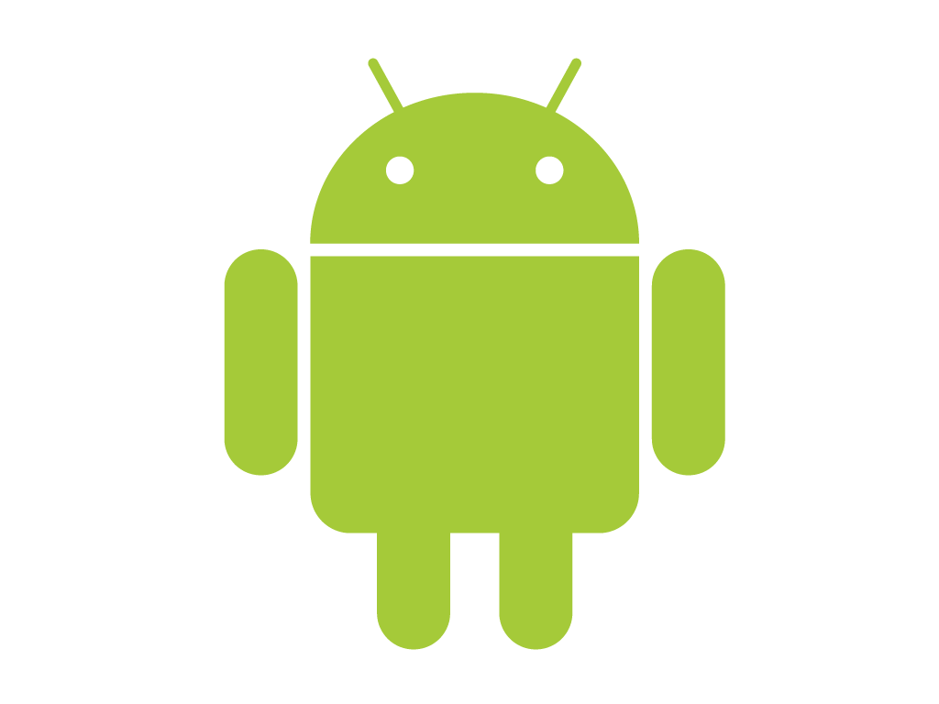

Android
Application
By
Gaurav Kawra
Raju Khanal and Sajan Panchariya

Slide 2

Outline
Introduction
Aims
Motivation and Justification
SMS Scheduler
Approach
Screen Shots
Demo
Conclusion

Slide 3
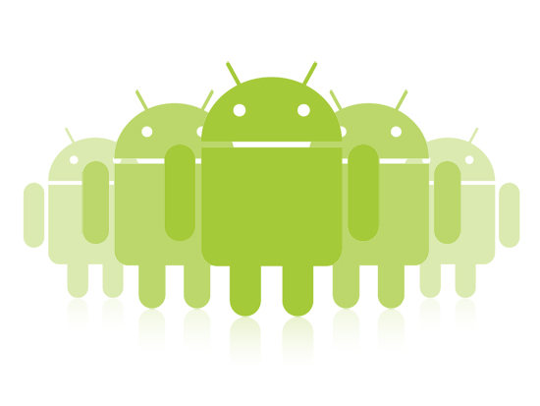
Introduction

Slide 4
Aim
1) To create an Android short message service (SMS) scheduler.
2) To integrate the above mentioned scheduler with templates.

Slide 5
Motivation and Justification
SMS Scheduler brings the following benefits :
-Increases the attendance rate at meetings appointments with SMS reminders
-Broadcast seasonal promotions
-Allows you to reach overseas clients at an appropriate hour
-Announce new products or services on their launch day

Slide 6
What is Android?
Android is a Linux-based operating system for mobile devices and tablets.^{[1]}
Key features:
Open
All applications are created equally
Fast and easy application development^{[2]}

Slide 7
SQLiteDatabase
In Android the SQLiteDatabase namespace defines the functionality to connect and manage a database.
It provides functionality to create , delete , manage and display database concept.
Arguably the most widely used database engine as it is used today by several widespread browsers , OS and embedded systems among others.
Unlike most other SQL databases, SQLite does not have a separate server process.
SQLite reads and writes directly to ordinary disk files

Slide 8
SQLite is generally a lot faster than SQL Server
SQLite also runs in process and reduces a lot of the overhead that a database brings--all data is cached and queried in-process.
However, SQLite only supports a single writer at a time (meaning the execution of an individual transaction).
SQLite locks the entire database when it needs a lock (either read or write) and only one writer can hold a write lock at a time

Slide 9
Create a Database
Simple steps to create a database and handle are as following.
Create "SQLiteDatabase" object.
Open or Create database and create connection.
Perform insert, update or delete operation.
Create Cursor to display data from table of database.
Close the database connectivity.

Slide 10
SMSManager
In Android, you can use SmsManager API to send an SMS Message.
<uses-permission android:name="android.permission.SEND_SMS" />
SmsManager smsManager = SmsManager.getDefault(); smsManager.sendTextMessage("phoneNo", null, "sms message", null, null);

Slide 11

SMS Scheduler
Take input from user about when and what time to send the SMS
Recipient of message
Add any template if required
Take the message
Create the scheduled SMS

Slide 12
Approach
Ask user to entry necessary data
Add data to database
Using the data to generate automated text messages.

Slide 13
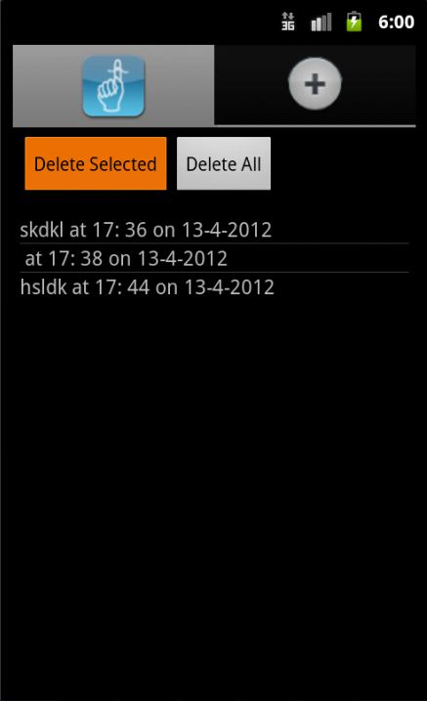
GUI of SMS Scheduler
Main Screen

Slide 14
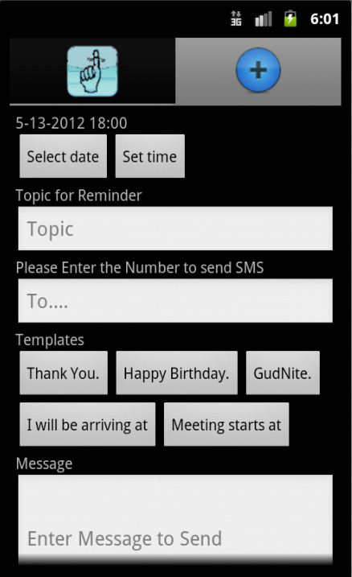
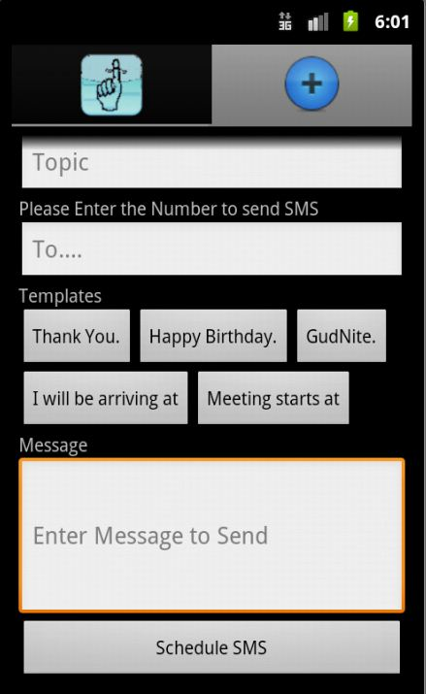
Scheduling SMS Activity

Slide 15
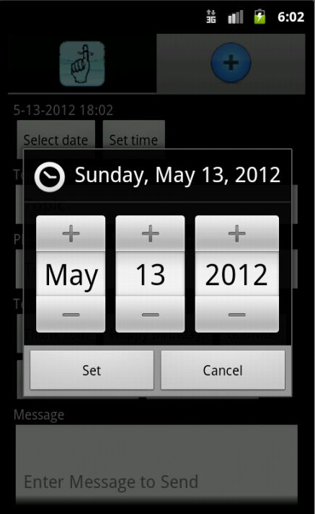
Date Picker

Slide 16
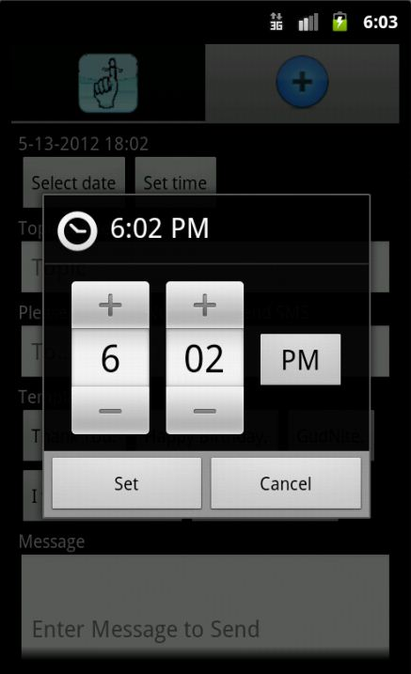
Time Picker

Slide 17
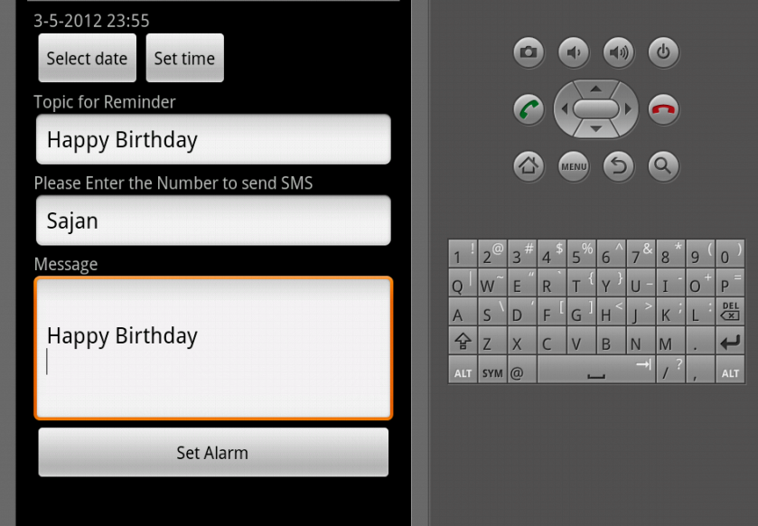
Setting other fields

Slide 18
Demo

Slide 19

Conclusion
We successfully made an android application that can schedule an SMS as per the entries given by a user. Furthermore we created a few templates that the user can use to aid their SMS writing experience.
The application also allows the users to delete a scheduled SMS or even delete all the scheduled SMSes if they desire to do so.

